Slide 1
MATCH-MAKER
Jose Rubio, Daniela Quiroga, Veronica Lopez

Slide 2
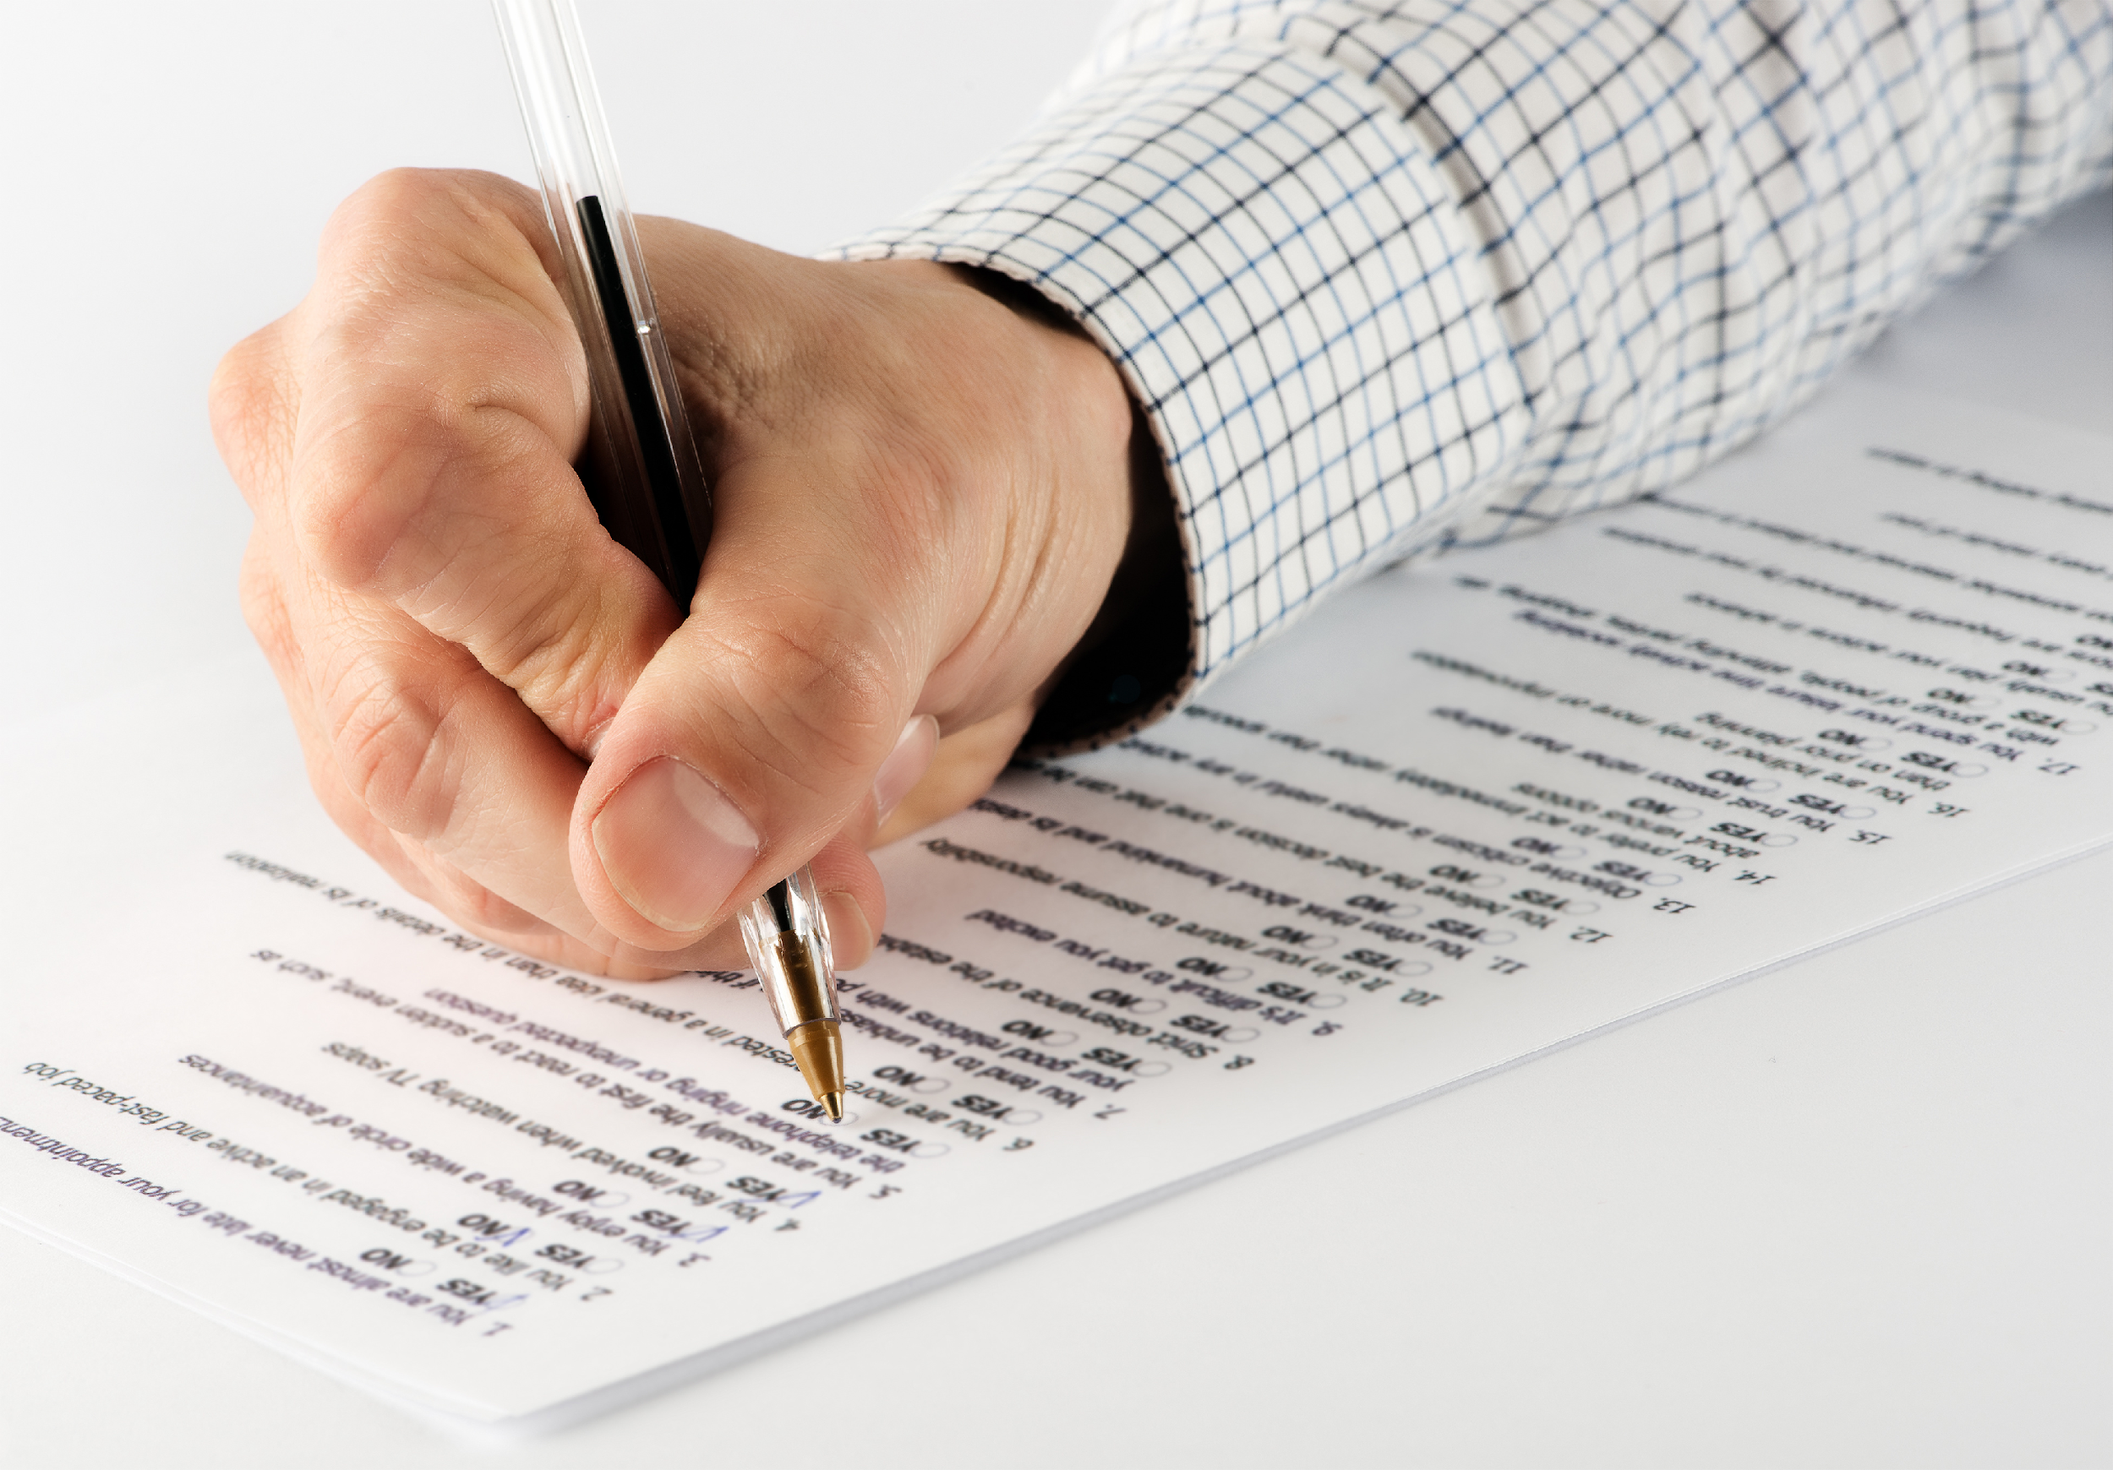
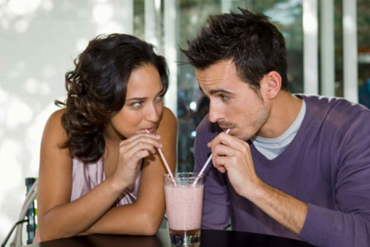
Where the Idea came from
http://www.ucl.ac.uk/iehc/research/behavioural-science-health/resources/columns/questionnaires.jpg
http://www.goingmobo.com/location-based-dating/

Slide 3
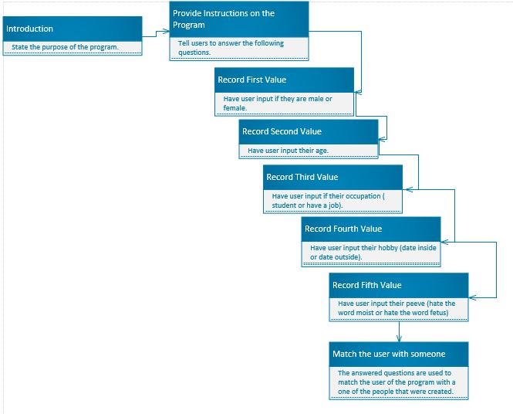
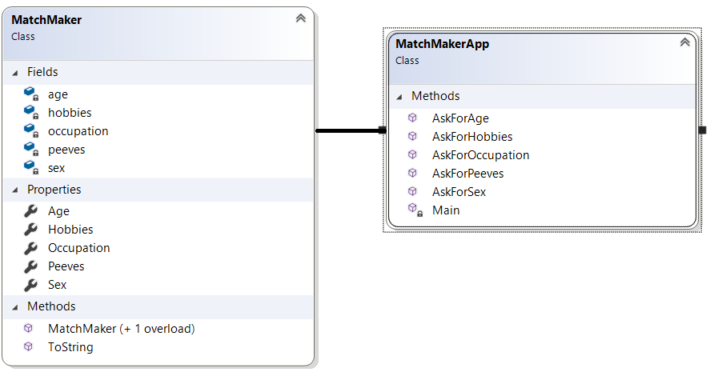
Analysis and Design
Goal: Create an application that would give the user an ideal match profile and eliminate the need for lengthy questionnaires

Slide 4
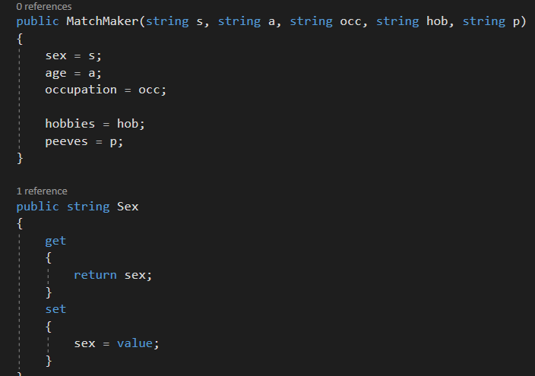
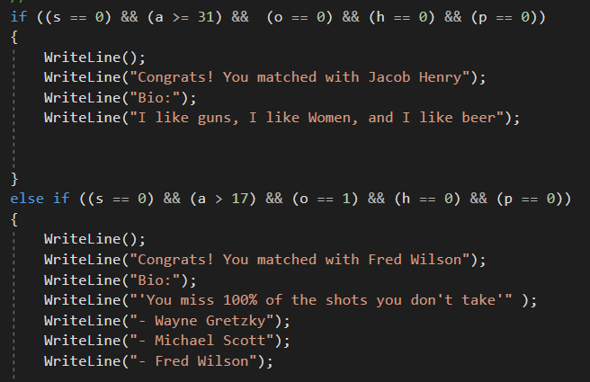
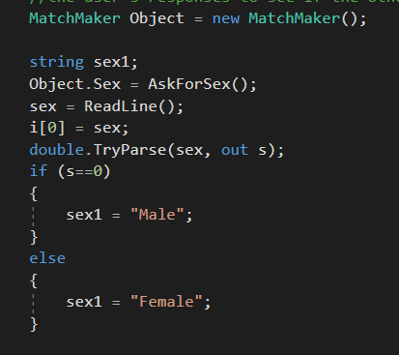

Code
MatchMaker.cs
MatchMakerApp.cs

Slide 5
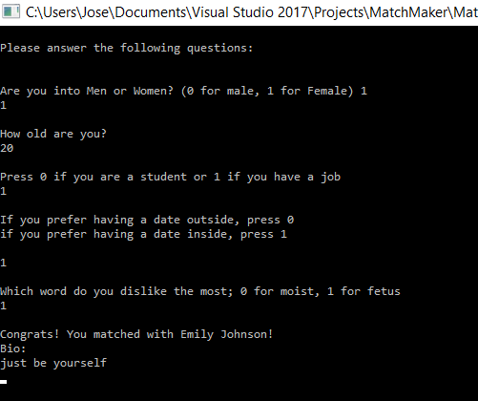
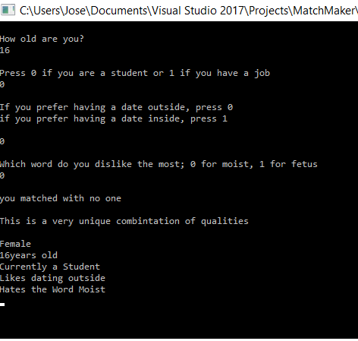
Results

Slide 6
Questions?

